Slide 1
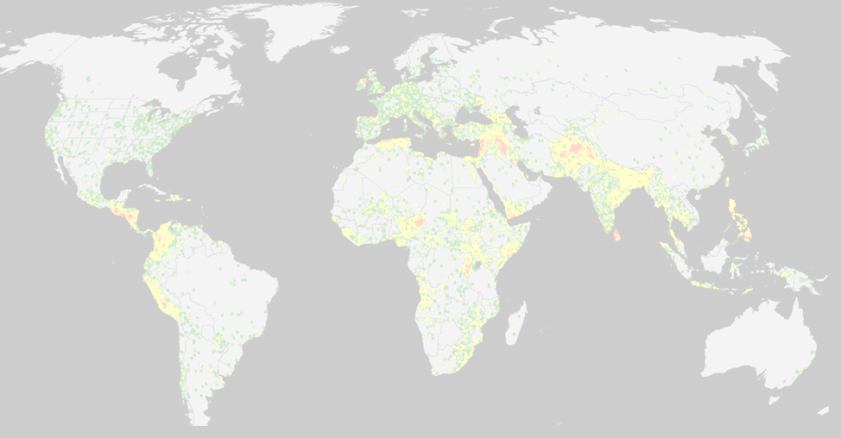

Max Herrera, Joshua Herrera, Patrick McDevitt, and Sunna Quazi
MSDS 7330 File Organization and Database Management
Section 405, Group A

Slide 2

About the Dataset
Location: https://www.kaggle.com/START-UMD/gtd.
Downloaded file is 29 mb
List of Terrorist Attacks from 1970-2015
156,772 terrorist attacks
137 Attributes

Slide 3

GTD defines Terrorism as:
"The threatened or actual use of illegal force and violence by a non-state actor to attain a political, economic, religious, or social goal through fear, coercion, or intimidation."

Slide 4

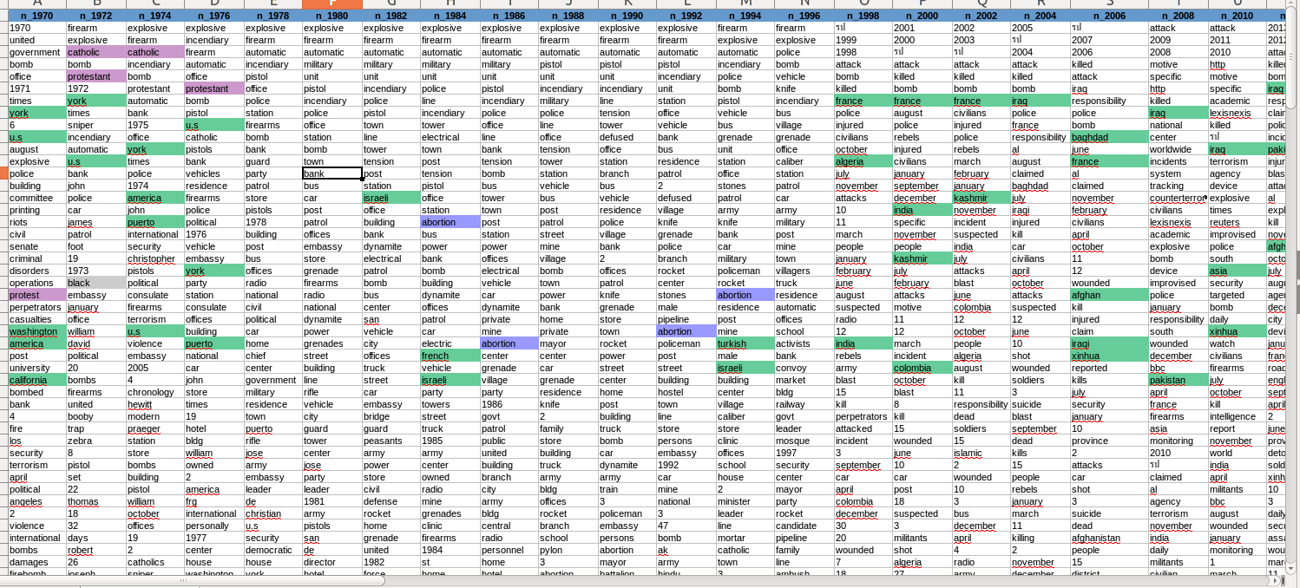
Feel the Data
Before loading the data, it’s a good idea to get a summary of what we are looking at
Below is a text analysis performed in excel on the top 200 words in the dataset
Observable Trends
1970s: Catholics vs. Protestants, US, Puerto Rico
1980s: Abortion, Israel
1990s: Turkey, Israel, India

Slide 5


Why Choose SQL?
We didn’t know about MongoDB until last week ;)
The data was received in tabular format
The 137 attributes are interdependent, which complement an relationship database
There was seemingly a great amount of redundant data, which would benefit from normalization

Slide 6

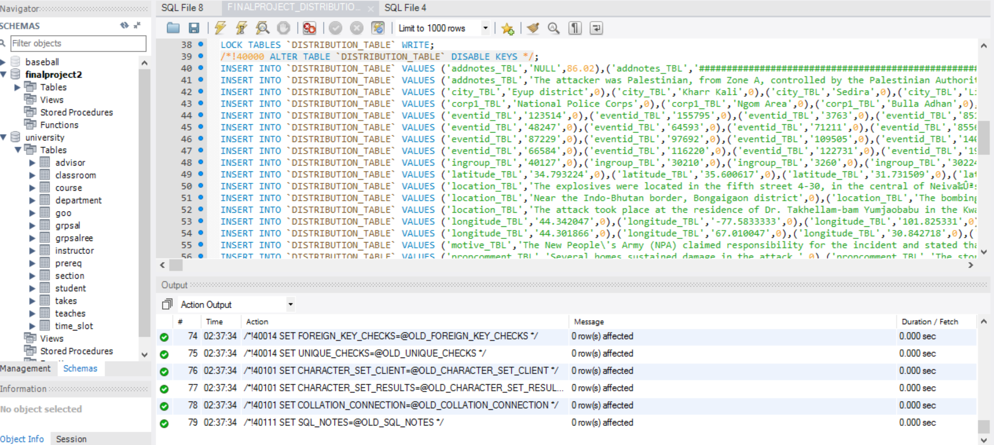

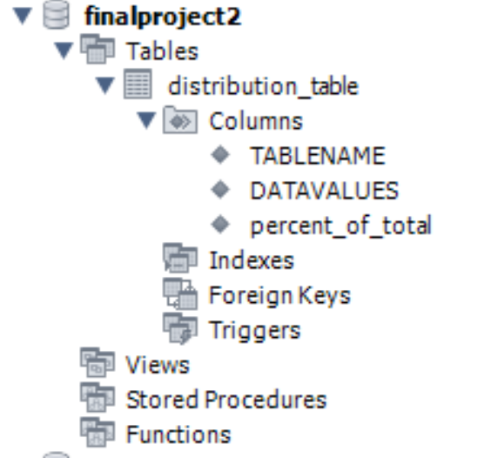
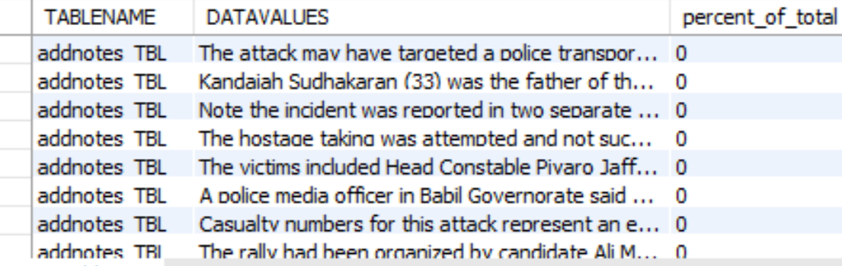
Data Loading Pitfalls
Initially, the GT data would not import into MYSQL
We needed to make each column varchar(MAX) initially. Each column was surrounded by triple quotes, so we cleaned up the data.
File size of DDL file 48.8mb
Data Definition File (DDL)
Loaded Schema
Table Excerpt

Slide 7

Data Wrangling
Import the data into a Microsoft SQL Server database.
We needed to make each column varchar(MAX) initially. Each column was surrounded by triple quotes, so we cleaned up the data:
Write scripts to determine the max length of each column, and alter the column width for each of the 127 columns accordingly.
Use the sliding window functions to determine distribution of values for each of the 127 columns.
Output the distribution of values per column into one table, DISTRIBUTION_TABLE.
Connect the SQL server to MYSQL to transfer the data using SSIS via an ODBC connection.
Perform a MYSQL dump of the data for the GT (I.e., the global terrorism table) and the DISTRIBUTION_TABLE and uploaded it into box so that it could be loaded by the other teammates.
This allowed the team to start with the same dataset.
All the scripts that were created to wrangle, and analyze the data can be found here. https://smu.box.com/s/zhbm2idikopnuhxfvcxtmc880nud5pxa. There were 22 scripts written to wrangle and profile the data. The SQL dump generated to scripts, which can be found in the importdataintomysql folder. The stored procedures and sql used is for both microsoft sql server and mysql

Slide 8

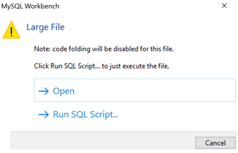
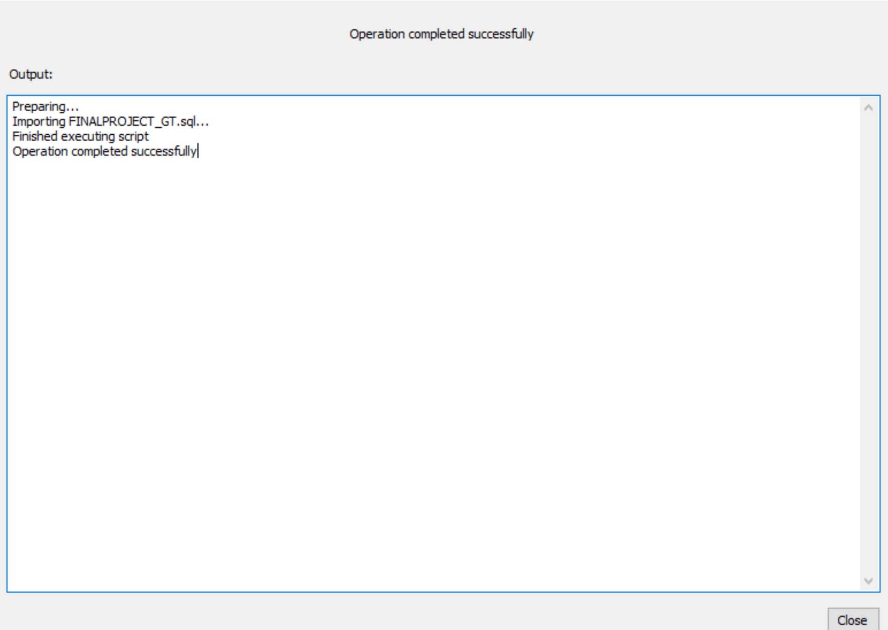
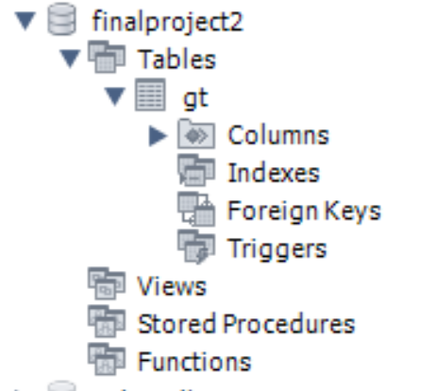
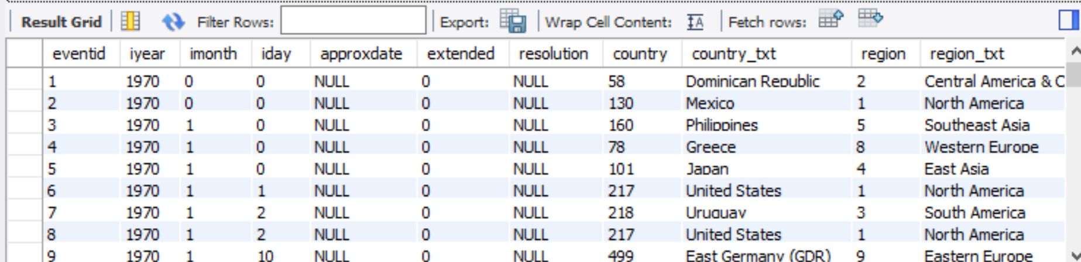

Our Framework
Final File size is 201mb (from 29mb)
Loading Data- Too Large
Importing
Loaded Schema
Table Excerpt
Summary

Slide 9

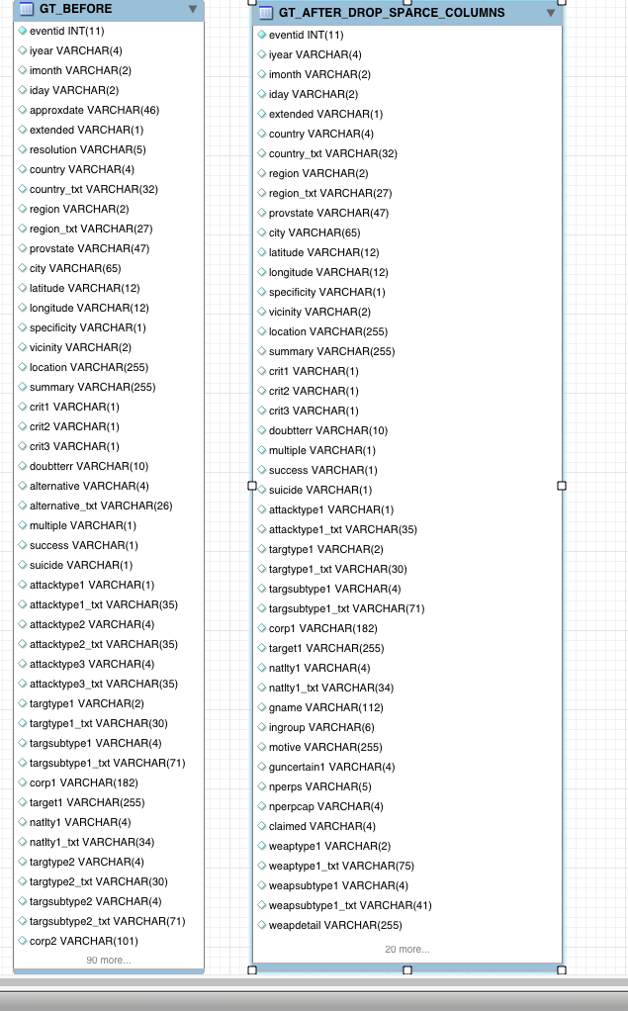
Data Profiling
Having moved the data to MYSQL, we ran scripts that determined which columns were sparse
The criterion for sparseness was that 80% or more of the column was NULL or contained ‘.’
“When you look into an abyss, the abyss also looks into you “
-Frederick Nietzsche
We created alter tables for the sparse columns and dropped them
At this point, the table was ready for normalization

Slide 10
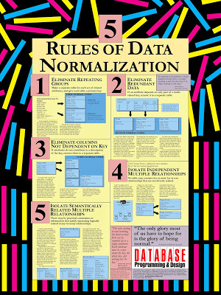
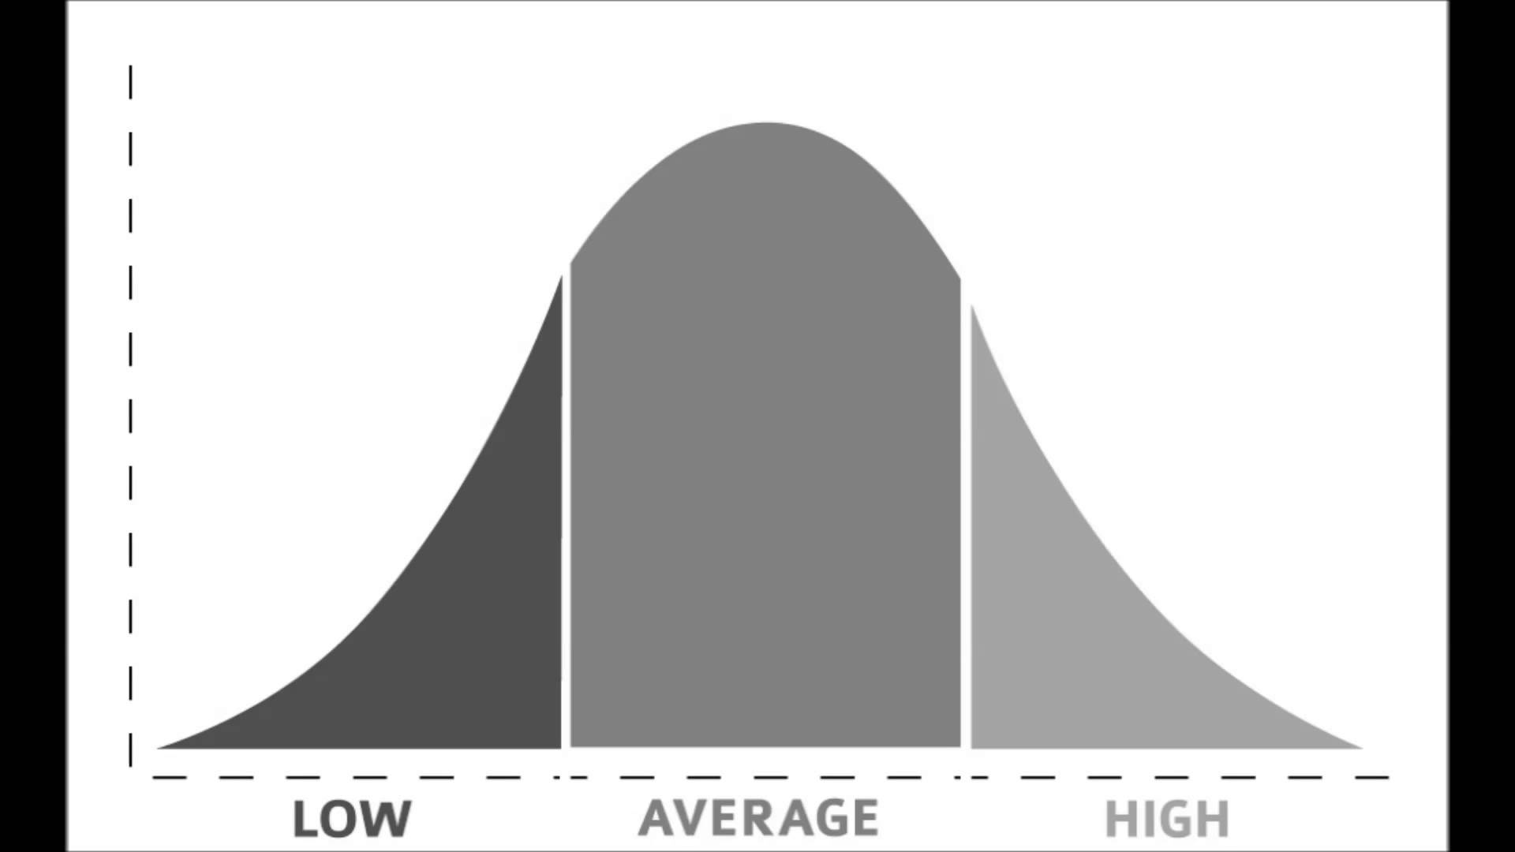
Data Normalization
The data was profiled using SQL Server Data Profiler
The profiler suggested that nine tables could be extracted from the large GT table.
Individual tables were created using the columns from GT. These nine individual tables were validated by joining back to GT.
The redundant columns were dropped form GT because they had been moved to the individual tables.
Primary keys were created on the nine tables.
From there, indices were created on the join columns in the GT table. Finally, a nine-way inner join was performed with the GT table to validate that everything has worked correctly.

Slide 11
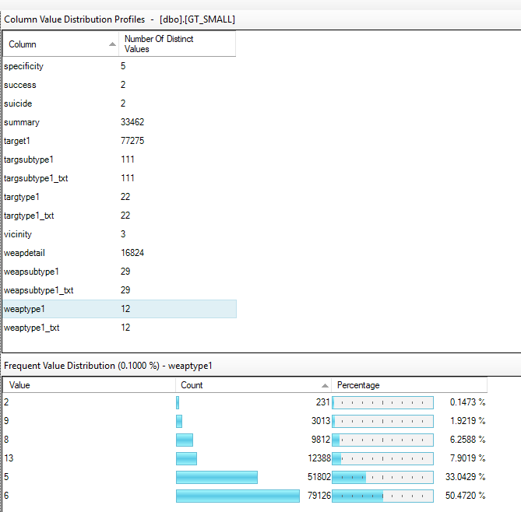
Before Normalization

Slide 12
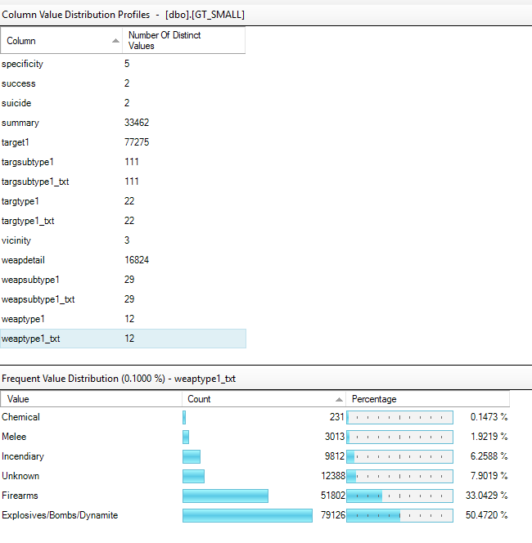
After Normalization

Slide 13
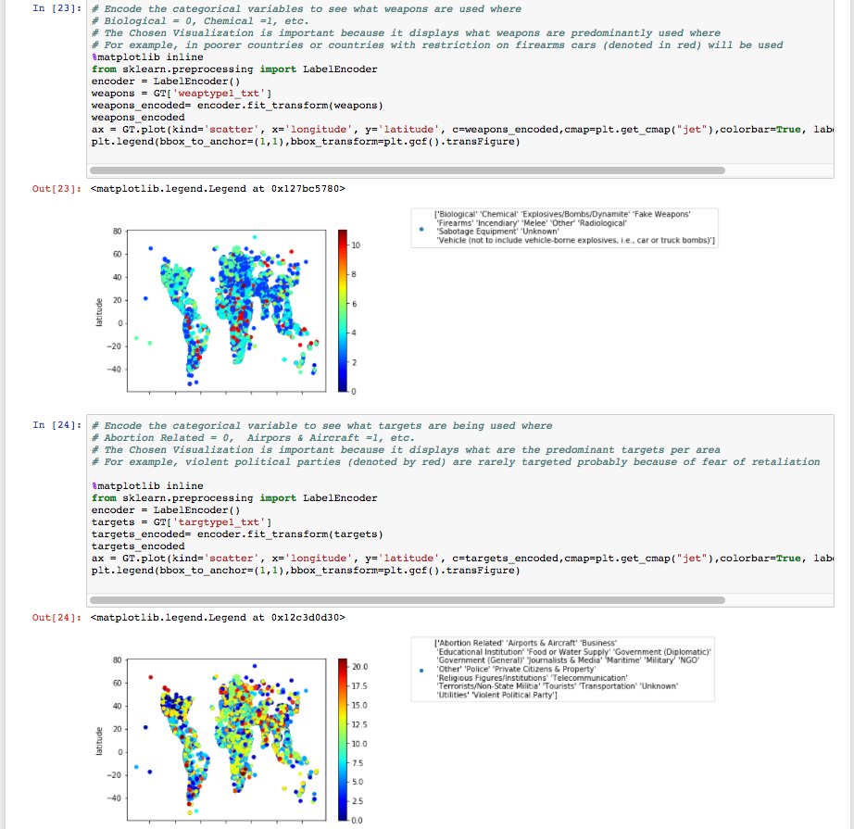

Data Analysis: Python
We used python to analyze the data, and found that weapon of choice in indigent countries is the motor vehicle.
Deduction: The favorite target of terrorists are abortion related centers and airports.

Slide 16
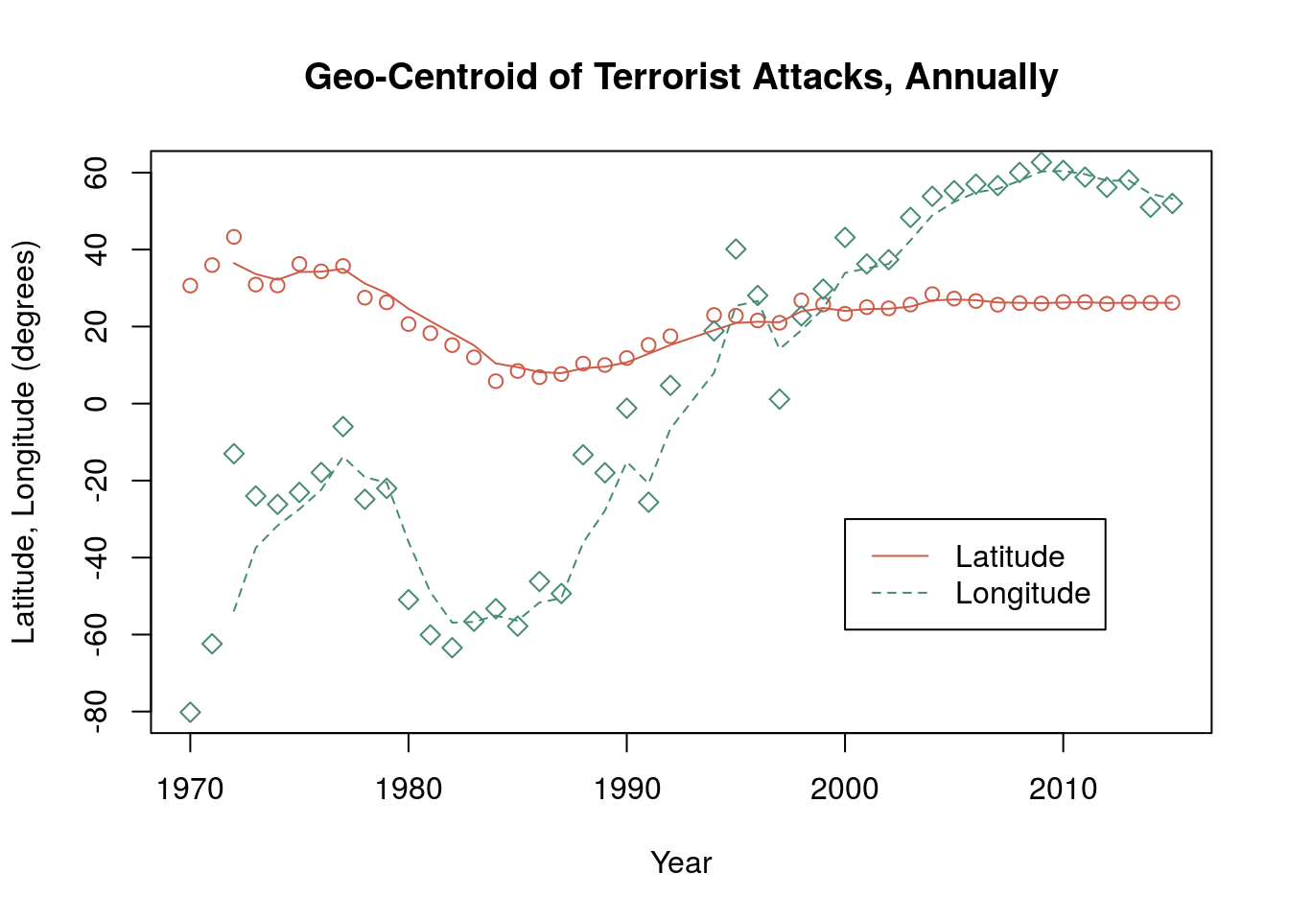

Data Analysis: R
To understand Event Clustering and Geographic Trends:
Each geographic center of attacks for each year is depicted in longitude and latitude
In 1970: the center was in the North Atlantic Ocean (just off the east coast of the US)
We can also observe that since 1970, attacks are moving eastward

Slide 17

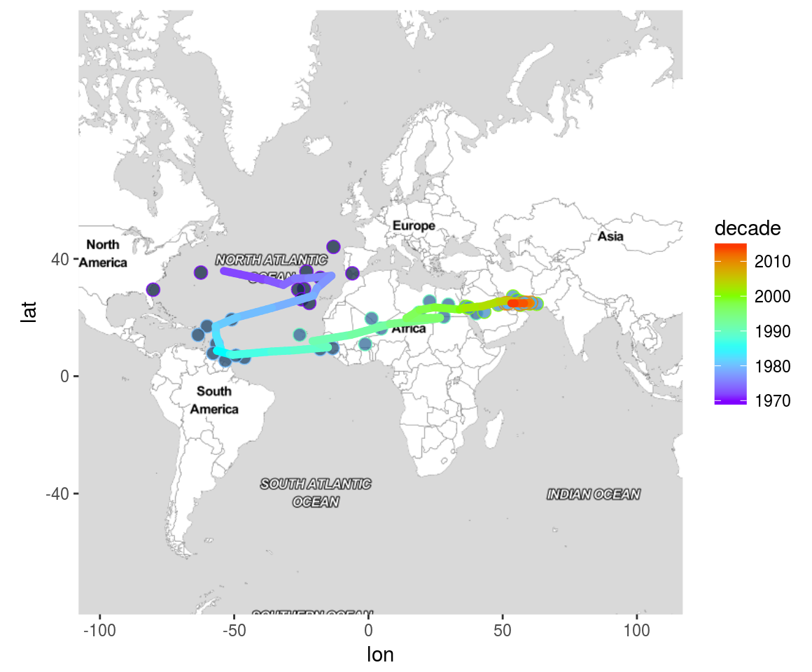
R Analysis: Geographic Clustering on Map Over Time

Slide 18

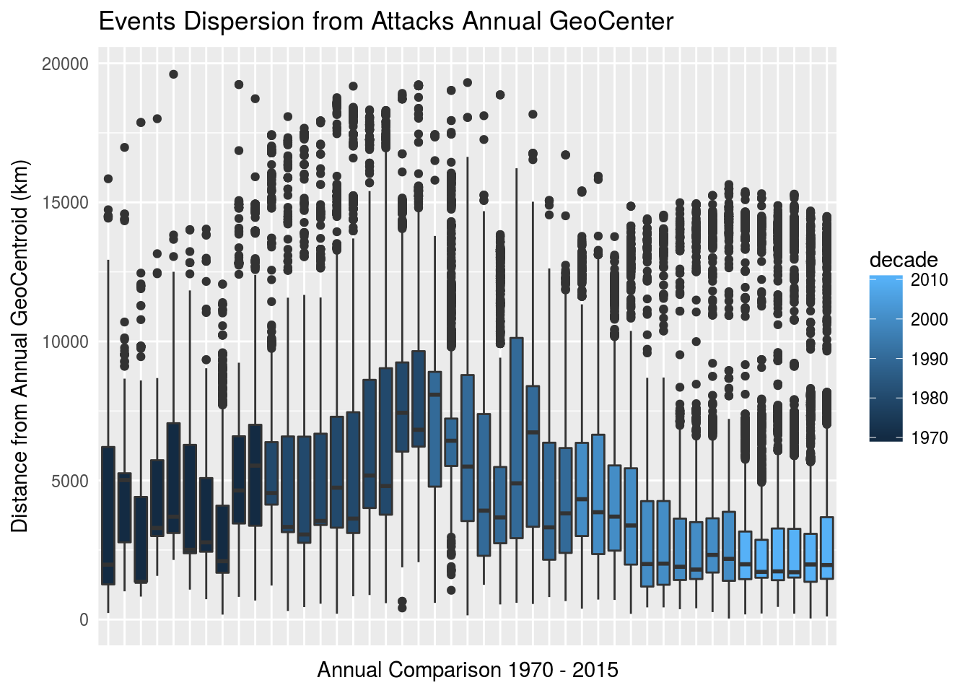
R Analysis: Geographic Center and Dispersion
1970s - large majority of events occurred within a 5000 km distance from the geocentroid
1980s - the average distance increases slightly (now located between western Europe or northern South America) and a clear bi-modal trend begins to emerge. There is a population of events that appear consistently at more than 15000 km from the annual center.
1990s - slight reduction in population distance from the annual mean, and also a return to a primarily uni-model distribution, as the overall centroid begins to march eastward across Africa
2000s - much stronger concentration of events to the annual center - now generally within 4000 km of the annual center and a reappearance of a bi-modal distribtion of events
2010s - least dispersion in the overall population difference from the annual centers. Thus, in the current era, there is a very strong concentration of terrorist events in the Mid-East, but also two other locations affected by 25% of the events.

Slide 19

Conclusions
Data is growing exponentially
SQL can be used to understand a new and seemingly overwhelmingly large datasets without destroying preexisting relationships
Our Python analysis allowed us to key trends that can allow us to predict and possibly deter future attacks
Motor Vehicles are the primary means of conducting terror
Abortion Centers and Airports are primary targets of terror
Nothing is constant. Our R analysis provides us insight into the evolution of modern terrorism so we can be better prepared for future developments

